Slide 1

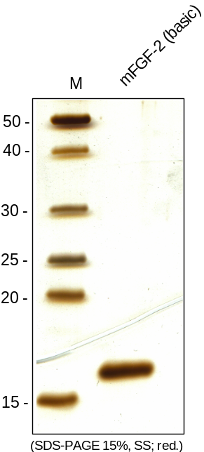
ReliaTech GmbH
Recombinant mouse FGF-2 (basic)
(expressed in E. coli; Cat #M30-014 / -015)
Fig. 1: SDS-PAGE (15%) with subsequent Silver staining of recombinant mouse FGF-2 (basic). Lane 1: MW marker; Lane 2: mFGF-2.
http://www.reliatech.de / orders@reliatech.de

